Slide 1

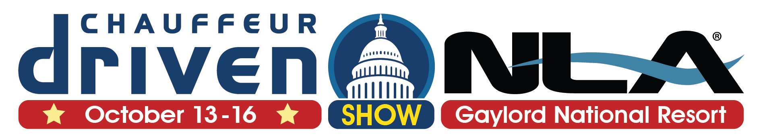


Slide 2



Under the Radar:
Are You Safeguarding Against
the Digital Danger Zones?
Speaker:
Tonia Dudley of IBM X-Force
AV Sponsor
Coffee Sponsor

Slide 3


Welcome & Thank You to Our Sponsors
AV Sponsor
Coffee Sponsors

Slide 4
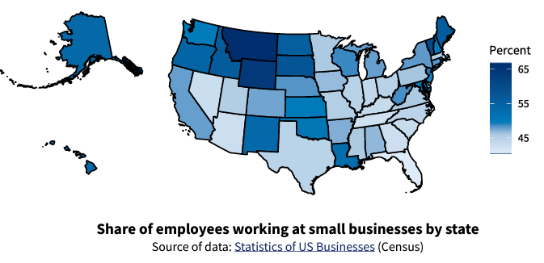
Technological
1.5M
Jobs created every year
$413.3B in exports
$370B spent on technology
44% of
GDP
32.5M
small businesses in the US
99.9%
of US businesses
are SMALL businesses
50% of all SMBs start at HOME
Added
12.9 million
jobs in US in the last
25 years
Employ
61.7 million
workers
Nearly
HALF of all US employees work for a
SMALL business
AV Sponsor
Notes:
So what is it that we’re protecting?
(read some of the data)
A threat to you is a threat to our whole economy
You get a cold and the country gets the flu
Those 1.5M jobs created every year, and the 50% of you starting your businesses at home…isn’t that critical to what America is about?
It’s the American dream. Go out on your own, take risks and if you’re successful, reap the rewards, move on up in life.
It’s fundamental to capitalism, democracy, to our way of life

Slide 5

Technological
65% of all cyber attacks are aimed at the US
61% of small businesses are targeted by attackers
Your employees defend 350% more social engineering attacks than large companies
51% of SMBs have no cybersecurity measures in place at all
46% of breaches impact companies with fewer than 1,000 employees
75% of SMBs could not continue operating if they were hit with ransomware
37% of ransomware victims have fewer than 100 employees
ONE of every 323 emails your business receives is
malicious
82% of ransomware attacks were against companies with fewer than 1,000 employees
Malware is the most common cyberattack aimed at
small business
AV Sponsor
Notes:
You might think, “I don’t have anything of value”
I don’t have deep pockets
How do they even know I exist? I’m too small to be a target
This is what you’re up against – (read data)
“Smaller companies are easier to hack,” “Cyber hackers view small businesses as a soft, easy mark versus big blue chip companies”
The flags in the middle are there for a reason – China, Russia, North Korea and Iran present the biggest cyberthreats to our country, our citizens, and our businesses, large and small

Slide 6



Small Businesses Struggle With an Increase in Cyberattacks
The FBI is worried about a wave of cyber crime against America’s small businesses
Cyber-attacks on small firms: The US economy's 'Achilles heel'?
AV Sponsor

Slide 7
87%
of small to mid-size businesses have data that could be compromised in an attack
Source: Digital
AV Sponsor
Notes:
So what do they want? Money and things they can turn into money – data, personally identifying data of your and your employees, and intellectual property
How do they turn data into money?

Slide 8
The Value of Data on the Dark Web
 | Price in 2022
Visa and Master Card (US) w/PIN | $20
American Express (US) w/PIN | $25
Stolen online banking logins (US) | $65
Complete Consumer Record/Identity | $1,170
Counterfeit Drivers’ License | $70 – 150
Hacked Crypto account | $90-250
An Estimated
$1.5B
Market
Source: https://www.privacyaffairs.com/dark-web-price-index-2022/
AV Sponsor
Notes:
They sell it. It’s a lot easier than robbing a bank in person.
These are the going prices on the dark web, the marketplace for stolen data
Remember, they want money and things they can easily turn into money
This is currently a $1.5B market
The size of the market has actually dropped – more data for sale, and a few of the big markets on the dark web have been taken down, but we’re still looking at approx. $6 trillion in global damages annually. It’s a huge tax on the global economy
How many consumer records do you have in your business? Do the math –I used to work with car dealers; the ave dealer has 50,000 consumer records – you’re worth a lot to a hacker.

Slide 9
The Cost of Hacking Services
 | Price in 2022
Ransomware as a Service (RaaS) | $100 - $1,000/month
DDoS on website | $5/hour
Monitoring phone activity | $21/month
Breaking into an email account | $90
Control of a website | $394
Hacking social media account | $230
“Full package deal: access to company devices and accounts with the data you need” | $1,800
Source: https://www.privacyaffairs.com/dark-web-price-index-2022/
AV Sponsor
Notes:
The cybercrime market is also a very efficient market
No regulation, no unions, no compliance, no OSHA, highly competitive and a very efficient market
It’s gotten really cheap to hire hackers and they hire each other for services they specialize in
Another reason to have high customer satisfaction – if a disgruntled customer can hire a hacker for $5/hour?
It’s called organized crime for a reason – these are business organizations run just like your or mine. They are organized into departments – engineering, software development, finance, marketing. They outsource when it makes sense, like to call centers. They partner with other organizations for operational efficiencies. They view this as a job no differently than you and me. It’s their malicious intent that separates them from us.

Slide 10
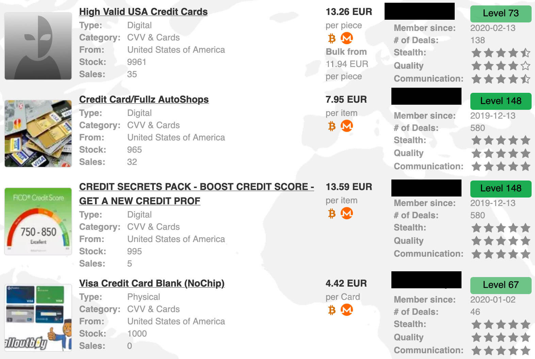
AV Sponsor
Notes:
Image of data for sale
You’ll notice on the right they have ratings, probably like your business
Most of us would probably kill for all these five star ratings on Yelp

Slide 11
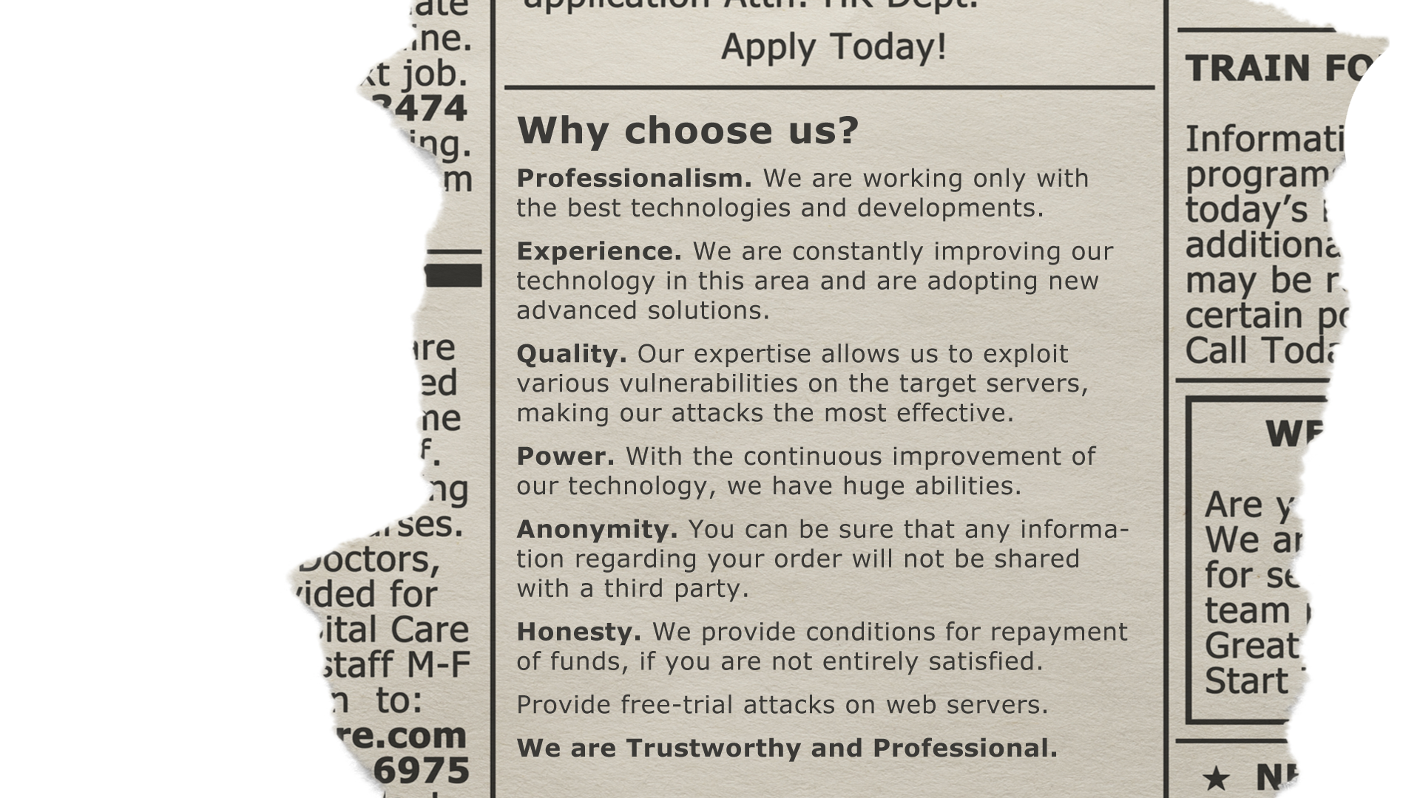
AV Sponsor
Notes:
Actual language from an ad from the dark web (I took some graphic liberties to make a point), bad guys advertising their services to other bad guys.
What ever happened to there is no honor among thieves? Money back guarantees.
These guys even have LinkedIn profiles. “I’m an experienced software developer with my applications deployed on millions of laptops around the globe” Sounds professional, right? Except that their application is malware.
What do thieves do – they walk down the street trying doorknobs. Go car to car looking for the one that’s unlocked. Don’t have to be perfect, but you have to do something. The worst thing you can do is nothing.
You don’t have to outrun the bear, you just have to outrun your buddy.

Slide 12

People
Process
Technology
AV Sponsor
Notes:
People in security – we love this analogy – security is a three-legged stool – people, process, technology
If you ask me, it’s really all people because people execute your process and people purchase install configure and monitor technology
So it’s all people

Slide 13

DOH!
95%
of all security incidents involved some form
of human error
Source: IBM
AV Sponsor
Notes:
But when we think about security, the first thing we think about is technology – firewalls, antivirus, protections to keep the bad guys out. But as I said, the most important part of security is people
People fall into two categories: well-intentioned people doing things they shouldn’t – maybe they’ve been tricked or just made a mistake, and bad people doing bad things
Technology is critical, but it doesn’t solve everything. Most bad things happen due to some human error along the way that opened the door to cybercrime

Slide 14







AV Sponsor
Notes:
These were all some massive data breaches over the last decade. What do all of these breaches have in common?
ANSWER ON NEXT SLIDE

Slide 15
UGH!
91%
of all breaches started with a spear phishing email
Source: Trend Micro
AV Sponsor
Notes:
They all started with a phishing email. Spear phishing is aimed at someone with access.
Remember, the thief is going to go try doorknobs.
Phishing emails used to be so obvious – misspellings, bad graphics…now they’re customized. Find the name of your office manager or controller on your website or LinkedIn, guess their email address, target the people with bank access.
Train your employees to be on alert for phishing emails and unsafe url’s

Slide 16
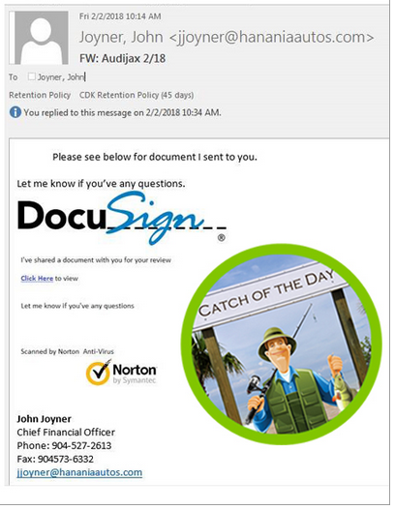
AV Sponsor
Notes:
Does this look real?
Story – from a customer in the sales cycle to the salesperson
Docusign serial number

Slide 17
People
Background Check Procedures for New Hires
New Hire Onboarding Procedures
Educate, Acknowledge
and Build Awareness
Drug test
Criminal background
checks
Credit report
Non-disclosure agreements
Policies and procedures: access
to systems and data
Rules of behavior: training access, acceptable use, passwords, email, internet, social media
Policies
Email
Social Media
AV Sponsor
Notes:
A lot of these are hopefully things you already do
Have processes, train your people on the processes and hold them accountable
What are the rules and policies? How do we do things around here? Is it ok to open attachments in emails from people you don’t know?

Slide 18
Security Behaviors
Password hygiene: password creation, password management, etc.
Using Multi-Factor Authentication (MFA or 2FA)
Installing the latest updates
Checking emails for signs of phishing
Backing up data
AV Sponsor
Notes:
Surveyed 3,000 people across the US, UK and Canada. From age 18 through retirement age
What did we ask about? These 5 behaviors
But we also asked about how you feel about cybersecurity – why?

Slide 19
Passwords
AV Sponsor

Slide 20
Q. What is the typical length of your passwords?
Under 6 character
7-8 characters
9-11 characters
Over 12 characters
AV Sponsor
Notes:
Poll on password length
The longer and more complex the password, the harder it is to crack
ADD Data on strength of passwords, use of personal information, changing a character at the end

Slide 21
21
AV Sponsor
Notes:
2% under 6
36% 7-8
46% 9-11
16% over 12
Length and complexity are very important – longer, more complex are harder to crack
You’re up against a machine – password cracker software tools

Slide 22
Q. How often do you use different passwords for your important online accounts (email, social media, etc.)?
Never [3%]
Sometimes [13%]
Half of the time [20%]
Most of the time [31%]
All of the time [33%]
AV Sponsor
Notes:
This is much better than last year
Why is it so important to use unique passwords?
Not just changing a character at the end

Slide 23

AV Sponsor
Notes:
How many of us had a Yahoo acct back in the day? We all did! And dial up AOL
When Yahoo was breached, did we care?
I haven’t used that acct in 10 years!
Criminals use passwords stolen in one breach to break into other accts
So you say, ok, I’m supposed to use a long complex password or a passphrase, and I can’t reuse them?
How do I remember all that? We’ll get to that

Slide 24
Q. What is your preferred method of remembering multiple passwords?
I write them down in a notebook 37%
I write them down in a document on my computer 9%
I store them in my phone 13%
I store them in my email 6%
I just remember them (without writing them down) 22%
I save passwords in the browser 6%
I use a password manager application 7%
AV Sponsor

Slide 25





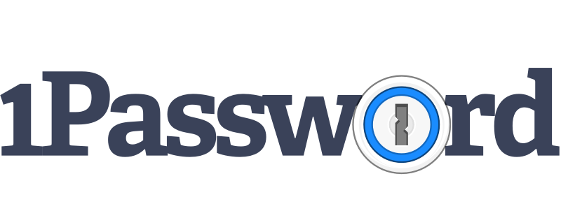




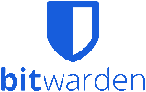
AV Sponsor
Notes:
These are great for home use
Share a family acct
Consumer Reports, Tom’s Guide
LastPass had one security incident in 2015 but no encrypted password vault data was compromised
https://www.investopedia.com/best-password-managers-5080381
Encryption: Simply speaking, this means that your data is translated into codes to make it harder for a bad actor to crack them. Password managers often use military-grade AES-256 encryption, considered to be extraordinarily difficult and time-consuming to crack, and some use several layers of encryption.
Zero-knowledge architecture: Many password managers are designed so that the system will never actually “know” your master password to access your account. This means your master password (the key to all your other passwords) can never be leaked by the service.
Biometric login: Just like on an iPhone, many password managers allow users to log in with fingerprints or face scans.
Multifactor authentication: This requires users to have access to multiple devices in order to log in. For example, if you’re logging in on a laptop, you may need to confirm the login on your cell phone.
Dark web monitoring: Some password managers continuously scan the dark web (where stolen information is sometimes sold or published) for any breaches of your personal data

Slide 26
Process
Access
Controls
Password
Policy
Verification
Off-Boarding
Process
CRM
Social Media
Third Parties
Uniqueness
Complexity
Who gets access
What are they accessing
When are they accessing
Why are they accessing
Revocation of credentials – systems, network, cell phone, email, social media
Keys
AV Sponsor
Notes:
Appoint somebody in your business ultimately responsible making sure processes are documented in every department, policies acknowledged when people join and then annually every year
Champion drive it through with department managers; hold the dept managers accountable
I’ve met small business owners that have implemented some really common sense processes to protect themselves. I met a car dealer that doesn’t put funds in his payroll account until the checks have been cut
Think about it, it’s pretty easy to guess when everyone gets paid – weekly, biweekly or 15th and end of the month. So if you got hit a day or two before you process payroll, when bank acct is full, some thief stole hundreds of thousands out of your bank account, or you got hit with ransomware the day before you’re going to process payroll, could you still pay your employees? Would you be late? What would happen to your employees if you were late? What would happen to your ability to recruit good talent if you were late on payroll? That salesperson who is being recruited by a competitor across town, would he or she leave?
Design your processes with security in mind
Verification – who needs access to what? Who has the ability to do things like change Pay To accounts for your vendors and how does that person or people verify? If your accts payable clerk gets an email from a vendor that says we’ve changed our bank routing and account number, please have a foolproof process to verify that – call the vendor at the number you know to be theirs and verify.
Survey –
do you have a firewall, do you have antivirus protection, but do you have written policies that all employees are trained on and have acknowledge annually (things like thou shalt not store company data, like a customer list, on a flash drive)?

Slide 27

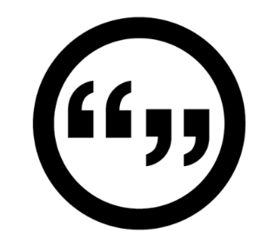
Two former Wolf Auto Center employees used their usernames, passwords, and email accounts to obtain data, confidential information and trade secrets.
AV Sponsor
Notes:
This is why you need really good processes to make sure you are as thorough when someone leaves your dealership as when they join.
Background check, check their references
What do you do when they leave?
Every one of your managers needs to know they are responsible and accountable to terminate access when people leave. You need revoke access within minutes or hours, not days.
This is a case from a car dealer. It gets really complicated. In this case the statute says the damages have to be worth more than $5,000, and it cost over 5K just for the owner to get the forensics evidence. Without that, the case would have been dismissed. Just to say someone accessed my system and stole my customers without my approval isn’t enough. So the main reason the case went ahead is because of the computer forensic evidence.
This is just one reason I recommend you have a relationship with a security professional or a managed security services provider with a forensics expert. More about that later.

Slide 28
Technology
Firewalls
Anti-virus:
PCs,
Laptops
Internet
Proxy/
Content
Filter
Virtual
Private
Network
(VPN)
Backups
Data
Encryption
AV Sponsor
Notes:
Some of you might be IT people in small businesses and I guarantee you there will be information today on technology
But if you’re a business owner who is overwhelmed with the technology piece, please know this. You don’t have to know technology, you have to know how to manage it. Think of it like bookkeeping, if you don’t know how to do it, you hire someone because the last thing you need is inaccurate finances and problems with taxes. You don’t go learn how to be a bookkeeper, but you learn enough to know the questions to ask and you use your management skills to assess whether the people or services you’ve hired are doing a good job. So hopefully attending today will help you do that.
So things like backups…when you ask your IT person, how do we do that, you should hear a solid answer, not, oh, when I remember, I run a back up to the external hard drive on my desk. You probably want to hear an answer that sounds like, we have a subscription to a cloud back up service that comes with security protections, data is encrypted, recovery time is X in case of a ransomware attack, we get a daily report that the back ups aren’t corrupted, etc.
PATCH –have a process to do updates and patches to all your software as soon as the patches are released – go back home and ask your IT guy – have you installed the latest patch for ….What’s your process? How do you check for available patches and how do you make sure everyone has them installed?
What’s your BYOD policy? If you let employees get company email or leads on personal cell phones, do you have technology on those devices to protect your data?

Slide 29
Multi-Factor Authentication
AV Sponsor

Slide 30
Use of Multi-Factor Authentication
43% of participants had never heard of MFA
Out of the 57% participants who had heard about it:
79% applied it at least once
94% of them reported they were still using MFA
AV Sponsor
Notes:
Once you can establish this, the data says people will use it
But we’ve got to spread the word
The acronym and the name aren’t helping us
It’s so much simpler than the name implies
Yes, it takes a little more time
But it’s really nice to know that some bad guy on the other side of the planet can’t access your bank acct

Slide 31
Feelings
AV Sponsor

Slide 32
Feelings of Intimidation
Q: How do you feel about cyber security?
Statement:
“I find cyber security intimidating.”
AV Sponsor
Notes:
Most people feel neutral but still 44% agree or strongly agree vs 29% neutral
This isn’t good for us – if you find something intimidating, your response is usually to avoid it
Almost identical to last year

Slide 33
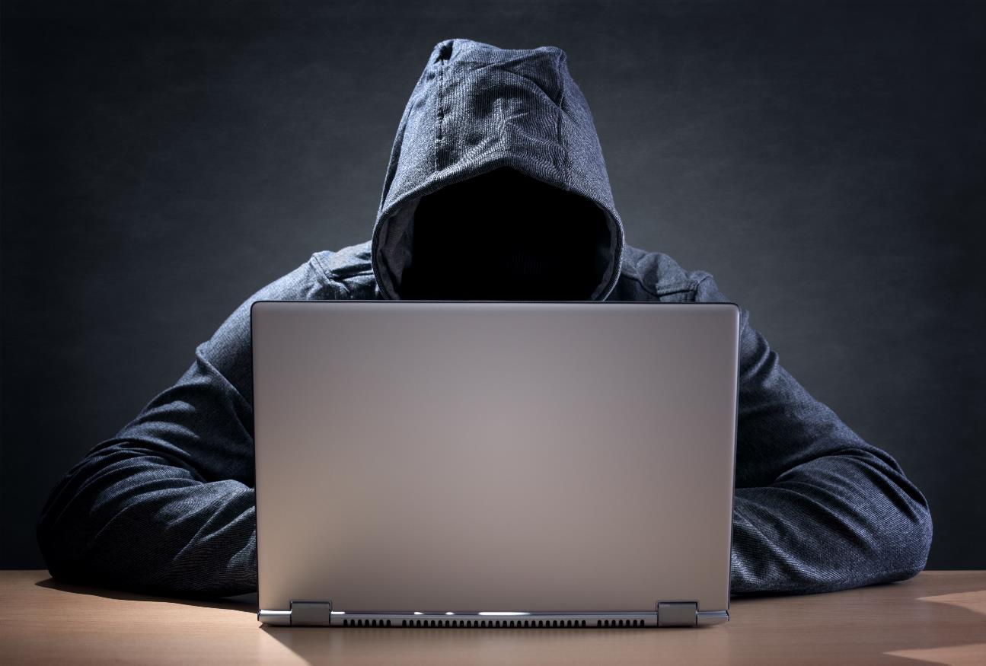

Slide 34
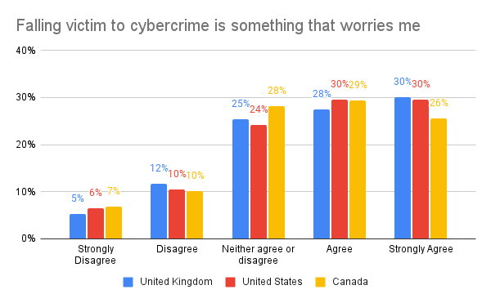
Worry
AV Sponsor
Notes:
I worry about cybercrime
I feel like I’m a likely target of cybercrime
43% of people think they are likely to be the target of cybercrime
I don’t think worry is a good motivator for behavior change
It’s a good motivator for anxiety

Slide 35
Security Behaviors
Password hygiene: password creation, password management, etc.
Using Multi-Factor Authentication (MFA 2FA)
Installing the latest updates
Checking emails for signs of phishing
Backing up data
AV Sponsor
Notes:
Surveyed 3,000 people across the US, UK and Canada. From age 18 through retirement age
What did we ask about? These 5 behaviors
But we also asked about how you feel about cybersecurity – why?

Slide 36
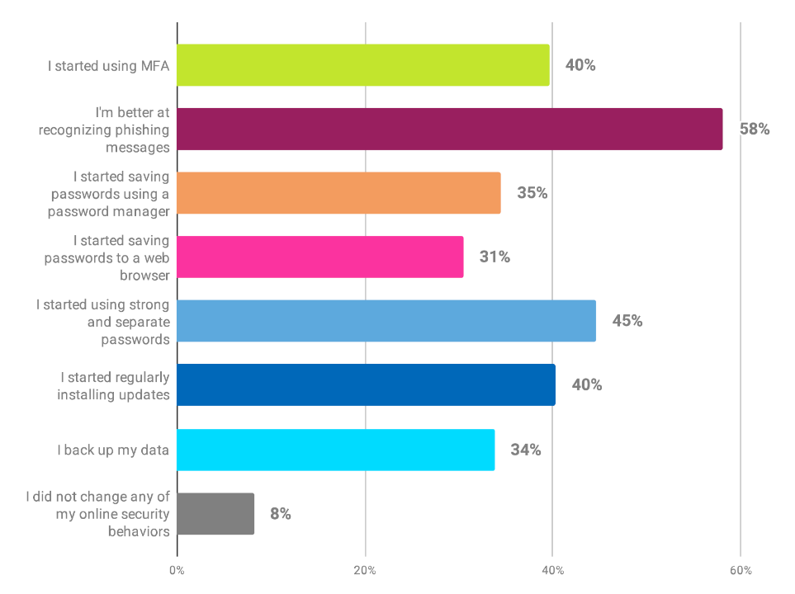
Security Behavior
AV Sponsor
Notes:
What did you do as a result of training? Public answers
Only 8% of people did nothing; included in that number could be people who didn’t need to make any changes, they’re perfect people, but I even know security professionals who aren’t perfect
That’s fantastic
Doing something, changing your behavior, based on knowledge is very hard. How many conferences or seminars have you been to where you learned a ton and got lots of ideas to implement, then you go back to the day-to-day, and it’s really hard to do. So you deserve a pat on the back for taking action on what you’ve learned in training. And if you haven’t, I hate to tell you, but you’re a laggard. You’re behind the times. Please join the rest of us who’ve implemented some best practices.

Slide 37
Five Step Approach
1. Identify
2. Protect
3. Detect
4. Respond
5. Recover
assets you need to protect
assets and
limit impact
security
problems
to an
incident
from
an incident
AV Sponsor
Notes:
A great place for SMBs to start is this 5 step approach from NIST
What are the most important things you need to protect – it’s people, data, technology, assets – but what data, what technology
Protect – this is the people, process, technology that we discussed earlier – training, policies, protocols, access controls, all those things – SANS has a wonderful policy template resource page, if that’s still on their website – don’t write policies from scratch when someone else has done the work for you
How will you know if something has gone wrong? Time is of the essence. Who will monitor your network? What software and systems will you have in place to tell you if something isn’t right.
It’s not if it’s when, so what will you do? Who is going to stop the bleeding and figure out exactly what happened? You probably want professional advice for this –a security provider. Car dealers in hurricane zones are really good at this. How will you conduct business if all the power and the cell towers are down, and you’ve got first responder vehicles that need a critical repair? Can you do business on paper temporarily if you get hit with ransomware? Have a written, printed plan and store it somewhere safe. Do you know your state’s breach notification laws? Do you know how to connect with law enforcement? Do you have a crisis communications plan to alert customers?
How do you regain customer trust? Do you need a PR firm to help you repair your reputation? What are your lessons learned? What did you do well and what would you do differently if it happens again? How will you prevent future incidents?
THE GOAL IS RESILIENCE

Slide 38
Advice
Written plan
Find experts you can rely on
Goal is resilience
Process, not an event
Champion, accountability
are you
ready?
AV Sponsor
Notes:
You have to make someone responsible – things don’t happen unless you make someone responsible and give them the authority to get it done – CFO, GM, Controller

Slide 39

AV Sponsor
Notes:
I want ya’ll to feel like this! Education is empowering. Join the 92% of people who use their training.
Instead of the hacker in the hoodie, I’m here to tell you there’s an upside. I’m selling positivity

Slide 40

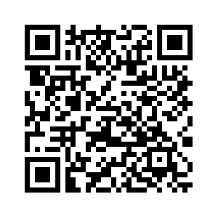
Resources:
Live w/ Q&A
Community
Impact Measurement
AV Sponsor
Notes:
Live:
One session per week for 6 weeks, 50-60 min w/30 min Q&A
Worksheets that guide participants to take practical actions between sessions
Access to peer community of other small business leaders
Access to exclusive offers from NCA partners

Slide 41
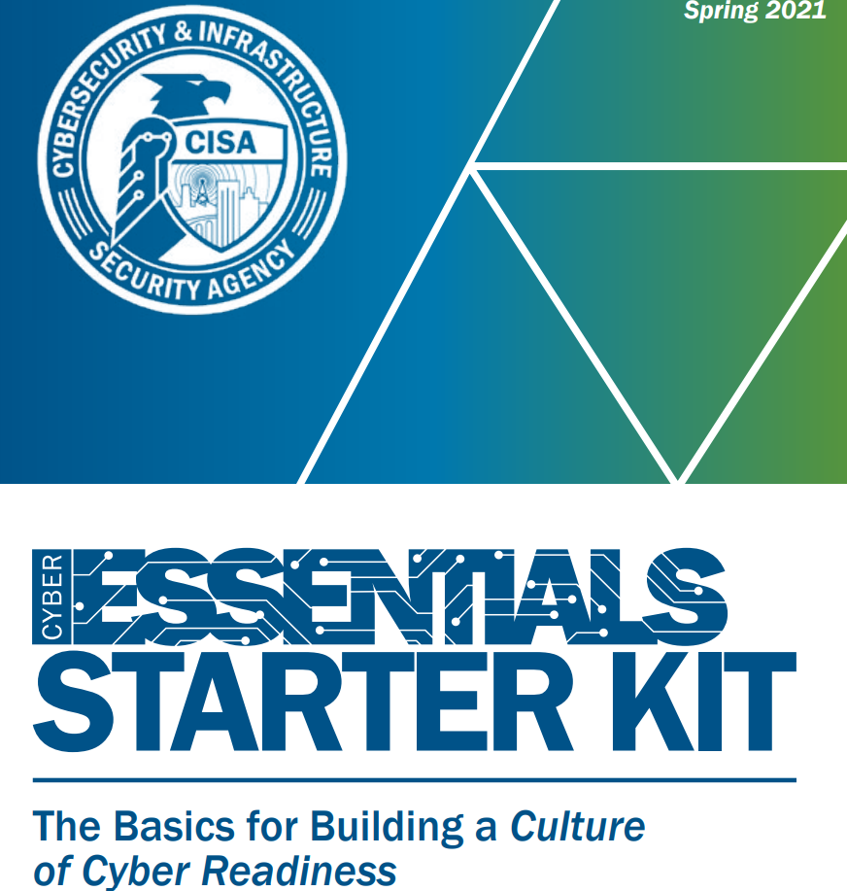
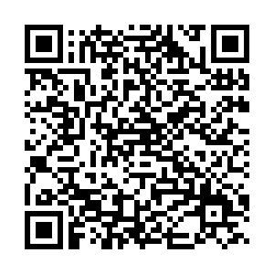
Resources:
AV Sponsor
Coffee Sponsor

Slide 42

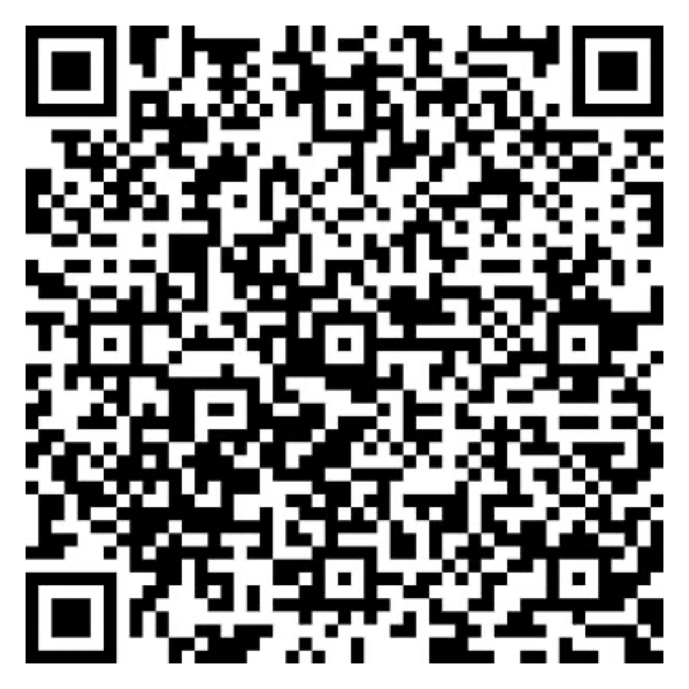

Let Us Know How
We Did!
Fill Out the Survey
AV Sponsor
Coffee Sponsor

Slide 43
Thank You for Joining Us!
AV Sponsor
Coffee Sponsor

